Slide 1
Rockbuster Stealth 2020 Strategy June 2025 Zosya Trimbacher

Slide 2
Project Goal
Rockbuster Stealth LLC aims to transition from a traditional DVD rental model to a modern online streaming service, leveraging its existing film licenses. In response to the growing dominance of platforms like Netflix and Amazon Prime, Rockbuster’s Business Intelligence (BI) team is tasked with supporting this strategic pivot through data-driven analysis and insights.

Slide 3
KEY BUSINESS QUESTIONS
● What was the average rental duration for all videos?
● Which countries are Rockbuster customers based in?
● Where are customers with a high lifetime value based?
● Which movies contributed the most and which contributed the least to revenue gain?
● Who are the top 5 customers from the top 10 countries who have paid the highest total amount to Rockbuster?

Slide 4
Descriptive Statistics at RocKbuster
Average movie rental duration is 5 days.
Average movie rental rate is $2.9.
Average movie length is 115 min

Slide 5
Movies and revenue
Our movie collection is organized into 16 unique categories, each playing a different role in driving overall revenue.

Slide 6
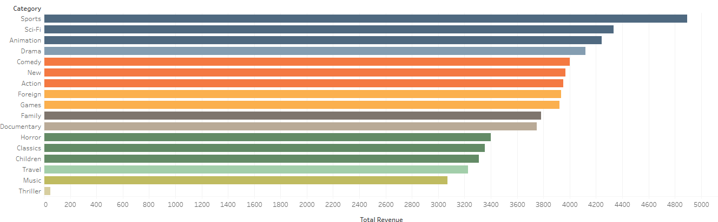
Movie categories bringing in most revenue
Our catalog data shows that the top-performing categories were Sports and Sci-Fi, each generating a significant share of revenue. Other strong performers included Animation, Drama, and Comedy. Analyzing revenue by category provides valuable insights into customer preferences and highlights which genres deliver the greatest impact.

Slide 7
Global Revenue

Slide 8
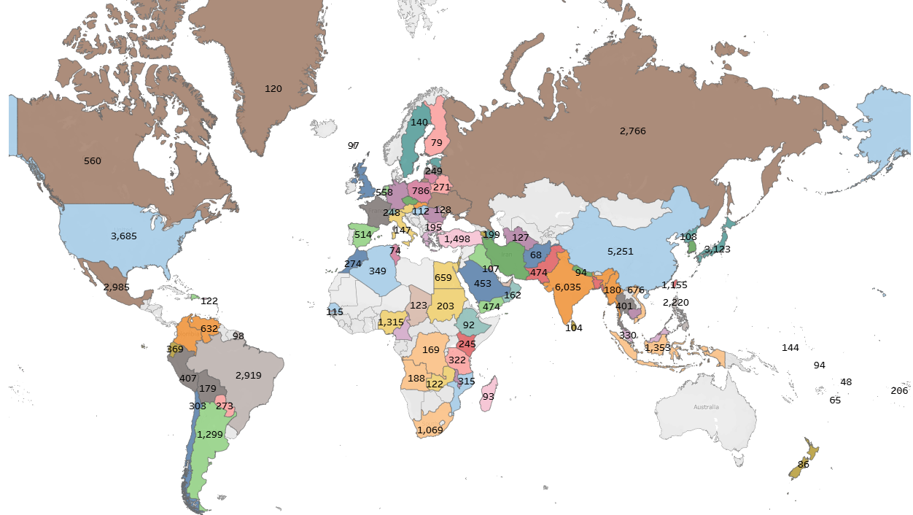
This map illustrates where Rockbuster’s customers are located, and the total revenue generated by each country. The highest sales figures are seen in India ($6,035), China ($5,251), and the United States ($3,685). Other key markets include Japan, Mexico, and Brazil, highlighting regions with strong performance and strategic importance for future growth.

Slide 9
Lifetime Value Customers

Slide 10
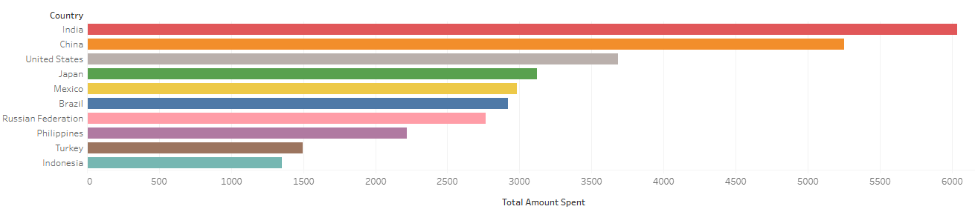
Top 10 Countries by Customer Lifetime Value
This chart highlights the countries where Rockbuster’s most valuable customers are located, based on total amount spent. India, China, and the United States lead the rankings, indicating strong long-term engagement and revenue potential in these markets. These insights can help guide targeted marketing strategies and service expansion plans.

Slide 11
Revenue Impact Highest and Lowest Performing Movies

Slide 12
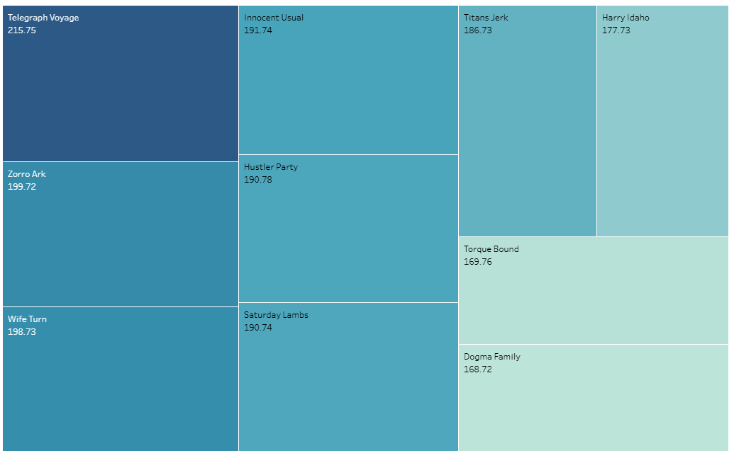

Top 10 movies contributed to most revenue gain

Slide 13
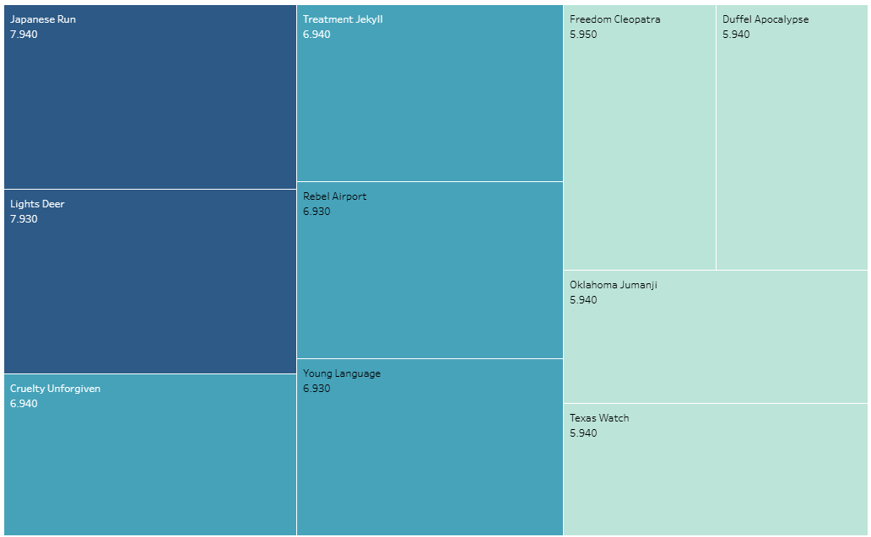

Top 10 movies contributed to least revenue gain

Slide 14
Valuable Customers Top 5 Customers by Spend — Across All Regions

Slide 15
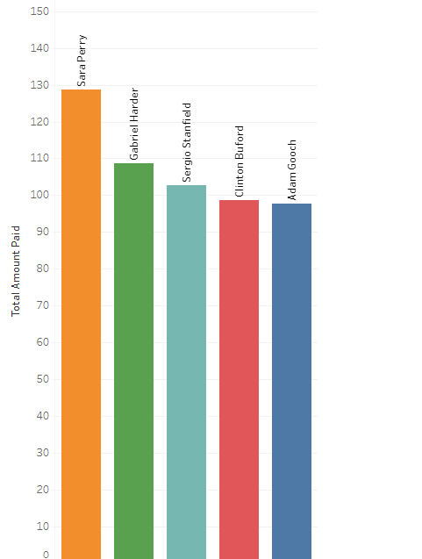
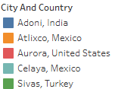
These five customers have contributed the highest total payments to Rockbuster, reflecting strong engagement and long-term value. The customer success team is considering loyalty rewards as part of a broader strategy to enhance retention and build stronger relationships with our most valuable users.

Slide 16
Conclusion Key Insights for Rockbuster’s Strategic Shift
Revenue Concentration: Sports, Sci-Fi, and Animation are the most profitable categories, suggesting strong viewer preference toward action-oriented and imaginative content.
Top Markets: India, China, and the U.S. lead in customer spending, highlighting them as high-value regions for initial streaming roll-out.
Customer Loyalty: The top 5 highest-spending customers, identified across various locations, reflect opportunities for retention-focused campaigns or loyalty rewards.
Movie Profitability: Certain titles significantly drive revenue, while others underperform—this differentiation is critical for future content curation and pricing.
Lifetime Value Distribution: High-value customers are concentrated in a few key countries, reinforcing the importance of regional targeting.

Slide 17
Recommendations & Next Steps Strategic Actions to Support the Streaming Launch
Target high-performing markets (India, China, U.S.) for the initial online rollout.
Prioritize licensing or promoting genres with the best performance (Sports, Sci-Fi, Animation).
Implement a loyalty initiative for top-paying customers to enhance retention and reward long-term engagement.
Phase out low-performing titles and focus marketing around high-revenue contributors.
Continue monitoring customer behavior and regional trends to refine pricing models and personalize user experience.
Pilot launch in top-revenue cities, followed by expansion based on customer density and revenue growth potential.

Slide 18
THANK YOU
Zosya Trimbacher
+49 17687999015
z.trimbacher@gmail.com Tableau https://public.tableau.com/app/profile/zosya.trimbacher/vizzes

